Slide 1
PROJECT ASSIGNMENT
Pablo de la Fuente, Fernando González, Simone Morettini
Model-Driven Engineering (DVA436)

Slide 2
Our goals were...
To define one language (metamodel) for the structure
To define one language (metamodel) for the behaviour
(Optional) To define a M2M transformation in QVTo that from two input models (structure model and behaviour model) generates an intermediate model
To define an M2T transformation in Acceleo that from two input models (structure model and behaviour model) generate code in a selected target programming language

Slide 3
Starting from the beginning
Our objective will be:
Design the models of these areas
Develop a model2text transformation (M2T) that will allow us to generate the code corresponding to the union of both models that corresponds to the objective functionality of the problem.

Slide 4
Metamodels to reach the goals
We have two areas of study within the proposed problem:
Structural model: Refers to the structural aspects of any program. Attributes that every program must have in order to develop its functionality correctly. The "skeleton" of the programme would be defined by this model.
Behavioural model: We would have in this model all those functionalities which a programmer manages to give shape to the program.

Slide 5
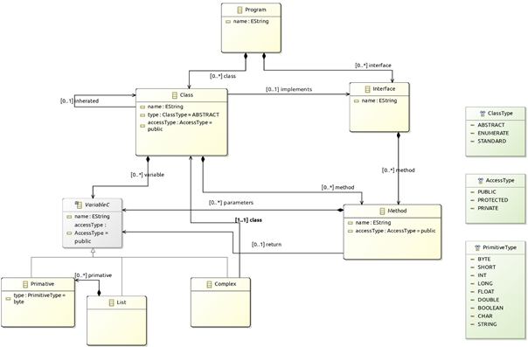
Structural model
Program
Class
Possible Interface
Name
Global Variables
Access type
Type
Name
Methods
Name
Access type
Parameters
Return type

Slide 6
Behavioural model
Container
Function (access type, return type, parameters, name)
“Block of code”
Expression
Variables
Operations (Mathematical and Logical)
Call other functions or System functions
Statement (condition)
Conditional statement (if, while, do while)
for (increment, update value)

Slide 7
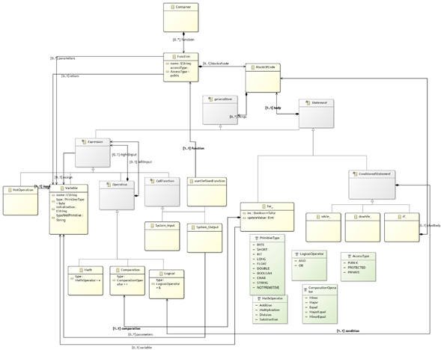

Slide 8
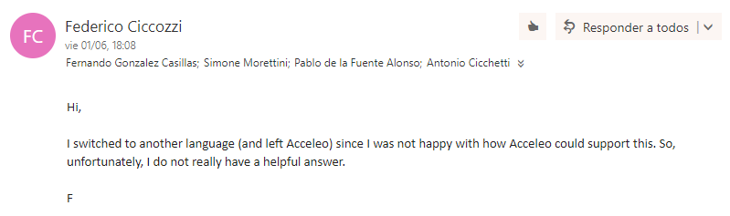
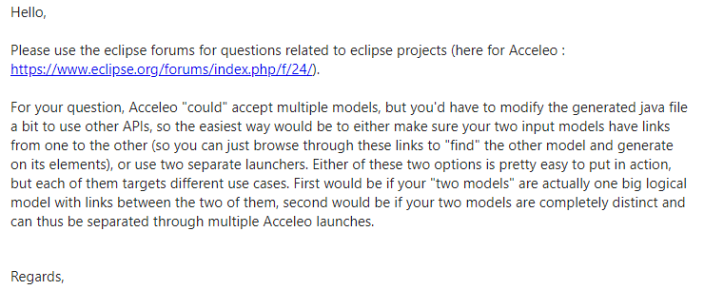

“THE problem”
Acceleo configuration
We ask to some people
We went the way we didn't want to go from the beginning… M2M

Slide 9
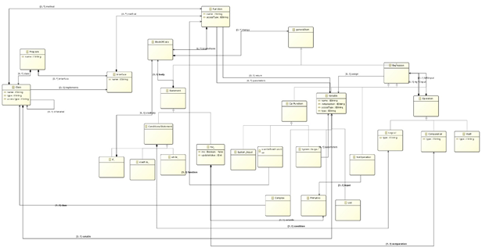
M2M transformation: “A mix of all”

Slide 10
And finally… M2T!!
A model-to-text transformation is defined using Acceleo
It takes the model described (result M2M) as input
It generates the code in an object-oriented programming language such as Java.

Slide 11
Long-term objectives
Creation of exceptions and the possibility to handle them
Possibility of adding libraries
Detect possible errors in operations checking the types of the operators
Access to the individuals from a list in order to operate with them separately
Other objectives would be the self-documentation of the code and support of type casting. As well as dedicated support for other programming languages

Slide 12
THANKS!!
:D

